Slide 1
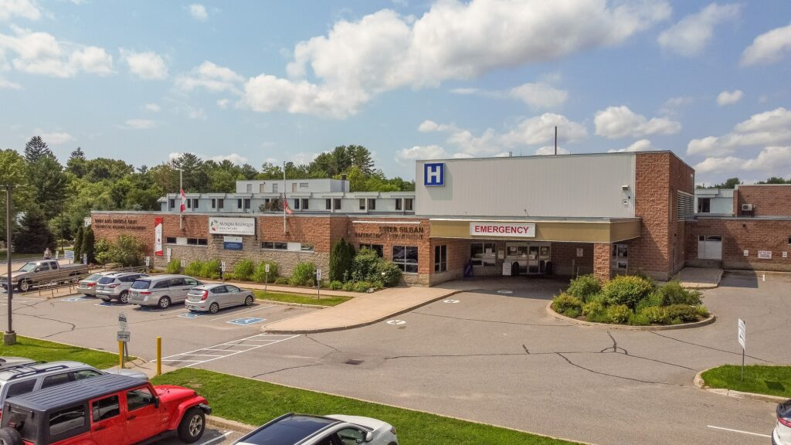
Welcome to the Public Forum Please Be Seated
SSMH.CA

Slide 2
Public Forum
Moderator: Tom Young
FORMAT
1. Opening Remarks – 2 Minutes / Candidate
2. Questions – 10-15 Questions (as time permits)
First Candidate will be given 2 minutes to answer
Subsequent Candidates given 2 minutes / Candidate
First Candidate given 1 minute reply
3. Closing Remarks – 3 Minutes / Candidate
GROUND RULES
Candidates are requested to keep comments focused on the hospital redevelopment plans specifically and healthcare generally for South Muskoka
Several questions have been shared with the Candidates in advance (not all)
Speaking will be timed and strictly enforced
SSMHC will have “fact checkers” who may interject where appropriate

Slide 3
Save South Muskoka Hospital Committee
Purpose Statement
Save South Muskoka Hospital Committee (SSMHC) demands significant change to the Muskoka Algonquin Healthcare (MAHC) capital redevelopment hospital plans to achieve two equitable, complementary acute care hospitals in Muskoka with sufficient acute care beds and departments at the South Muskoka Hospital site to service the projected population and demographics of South Muskoka.
SSMHC is guided in its advocacy by established healthcare planning principles, including fostering sustainable healthcare, close to home, to support the expansion of healthcare and better patient outcomes in South Muskoka.
How can you help take part?
Visit www.ssmh.ca/action to learn more

Slide 4
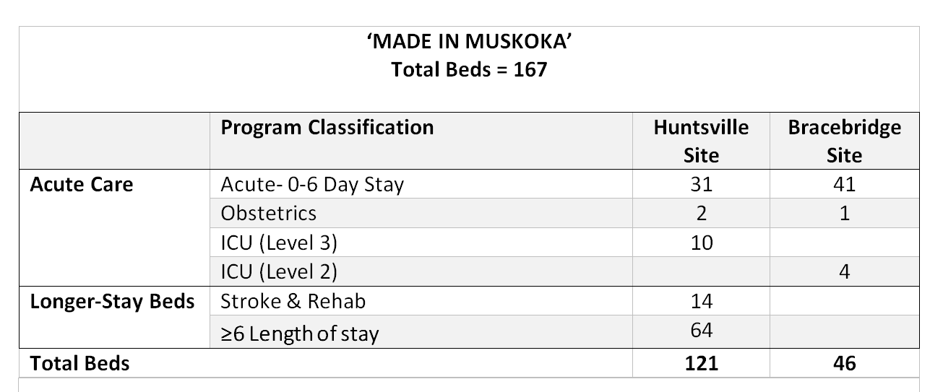
Current Bed Allocation (Total Beds = 123)
MAHC Stage 1.3 Submission to the Province (November 2024)

Slide 5
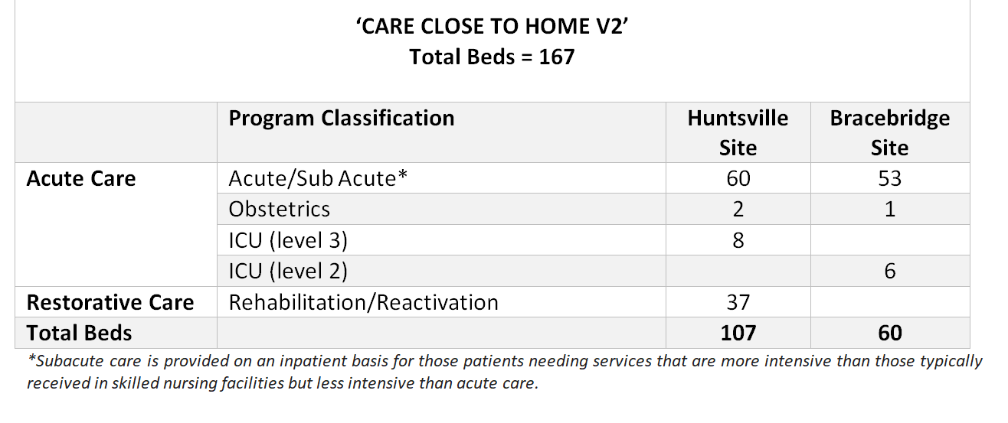
More acute care beds with a balanced distribution
Elimination of patient transfers on “6-day stay” condition
Continuity of care with local physicians
Reduced transit between sites
Proximity to family and friends = better patient outcomes
SSMHC strongly advocates for the Care Close to Home model

Slide 6
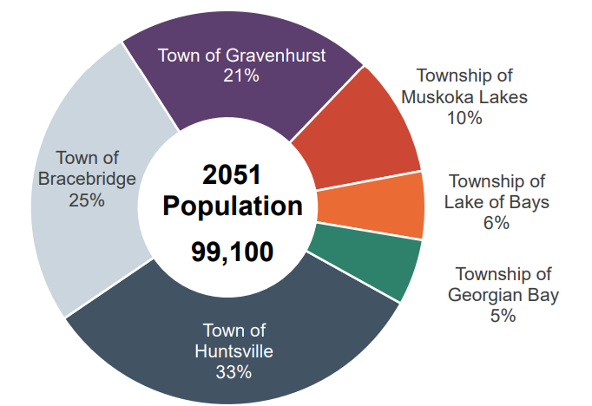
Projected Population in Muskoka by 2051 (District of Muskoka, 2024 Growth Strategy Study)
Today, 1 bed/550 persons in South Muskoka
Made in Muskoka, 2051, 1 bed/1,200 persons in South Muskoka
By 2051, over 55,000 residents in South Muskoka (vs. 37,000 today, 2021 census)
These statistics do not include seasonal residents, for which South Muskoka has at least double the amount of seasonal residents at 45,000 (District Second Home Study 2023) vs. 20,000 in the north

Slide 7
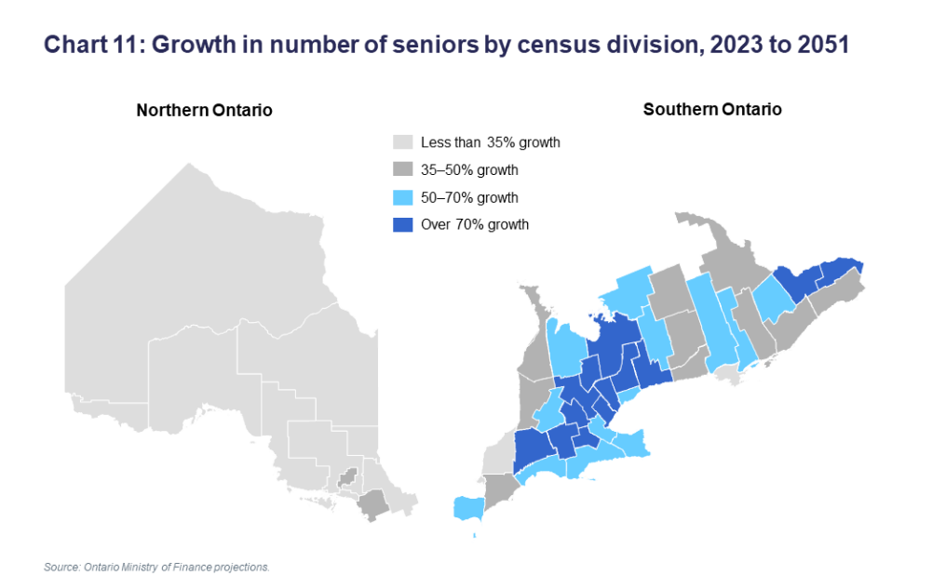
Demographics by 2051
Muskoka identified to experience a 50-70% growth in number of seniors to 2051 (Ontario Ministry of Finance)

Slide 8
Hospital Capital Planning and Policy Manual (Ontario)
SSMHC asserts that several of the province’s key planning principles have been ignored by MAHC and has not been pursued by the province
Change remains possible at the provincial level
Enhance your understanding of the redevelopment process at the province: www.ssmh.ca/resources

Slide 9
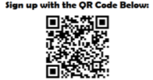
Join the Save South Muskoka Hospital Committee as a Community Member
Newsletter Updates
Invitation to Events
Make your Voice Heard
Visit
https://www.ssmh.ca/community-membership

Slide 10
Election Day:
Thursday, February 27
Public Oversight on the Hospital Plans Remains:
MAHC Made in Muskoka plan currently under provincial review with the Ministry of Health. Government approvals are required and change is possible
Provincial Cabinet will be required to approve building costs
Local Share Contributions from local municipalities may evolve

